Slide 1
Indroduction TO DATA ANALYSIS:PANDAS
By Lihalakha Cetric

Slide 2
CONTENTS
What is Pandas
Series
Basic operations on series
Dataframe
Basic operations on Dataframe
File related operations on Dataframe
Visualization

Slide 3
What is Pandas
Python library
A tool for data processing which helps in data analysis
Provides functions and methods to efficiently manupilate large datasets
Kinda like excel but for embedding in programs
Has to data structures: series(1-d array) and DataFrame(2-d array)

Slide 4
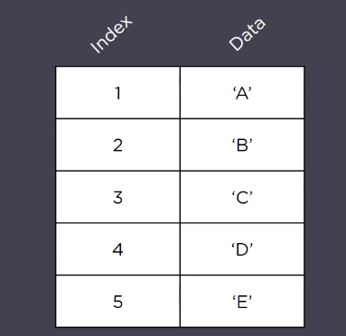
Series
1-d array with labels. Can contain any datatype including integers,strings,floats,python objects etc

Slide 5
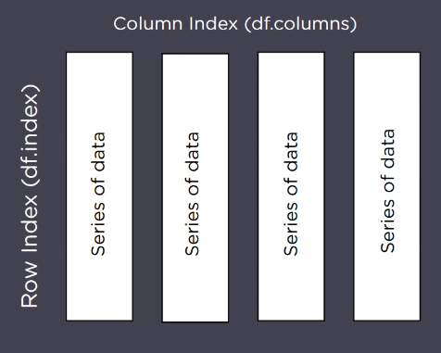
DataFrame
2-d array data-structure with index and labels. We can use labels to locate data
Resembles spreadsheet e.g excel

